Slide 1
How Do We Know What We Know?

Slide 2
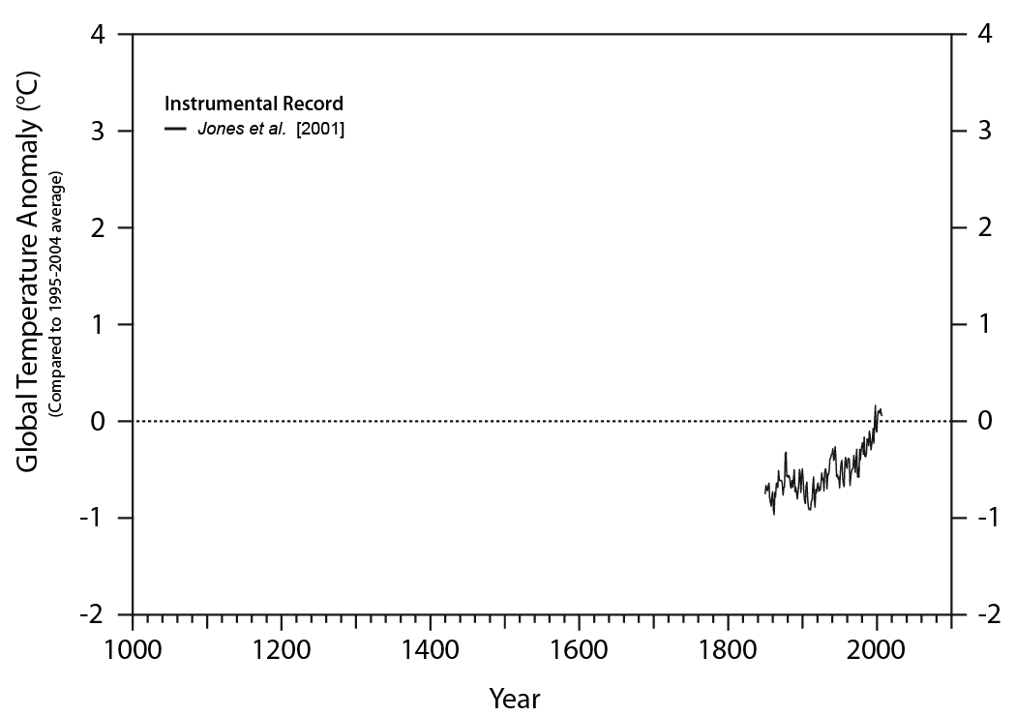
The zero line is the 10-year average of global average temperature for the years 1995–2004, centered on January 1, 2000.
Notes:
Based on an article and graphics by David S. Chapman and Michael G. Davis, Department of Geology and Geophysics, University of Utah, Salt Lake City, Utah.
Chapman, D., & Davis, M. (2010). Climate change: past, present, and future. EOS, Transactions, American Physical Union, 91(37), 325–332.
Temperature records from a wide variety of geographically diverse proxies show a consistent picture of our warming world.
Instrumental Record
Surface temperatures for Earth are most reliably known for the period 1850 to present. This is the time for which there has been reasonable global coverage of stations measuring temperature in a systematic manner. The records show that since 1850, global average temperature increased by about 0.8°C, with much of the warming occurring since 1975.
----------------------------------------------------------------------------------------------------------------------
Philip Brohan and colleagues from universities in the United Kingdom published this record of global average temperatures (called HadCRUT3). The data set was based on a previous global temperature data set called HadCRUT which was derived from instrumental records. The old temperature record was modified to reflect improvements in estimating sea surface temperature and land data. The study also included a comprehensive set of uncertainty estimates for the data, including estimates of measurement and sampling error, temperature bias effects, and the effect of limited observational coverage on large-scale averages.
Brohan, P., J. J. Kennedy, I. Harris, S. F. B. Tett, and P. D. Jones (2006), Uncertainty estimates in regional and global observed temperature changes: A new data set from 1850, J. Geophys. Res., 111, D12106, doi:10.1029/2005JD006548.

Slide 3
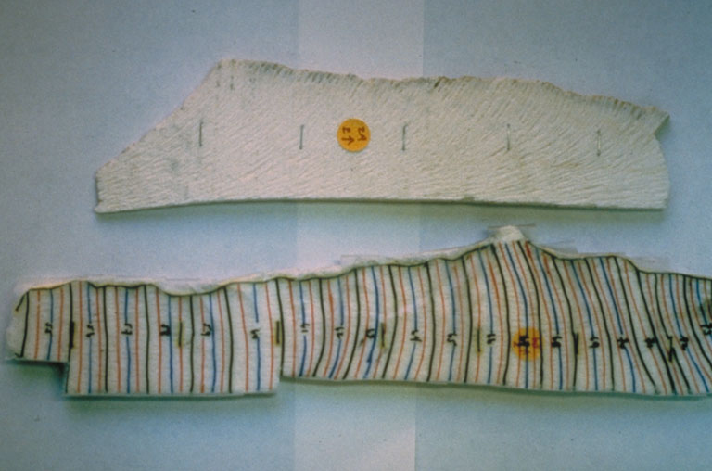
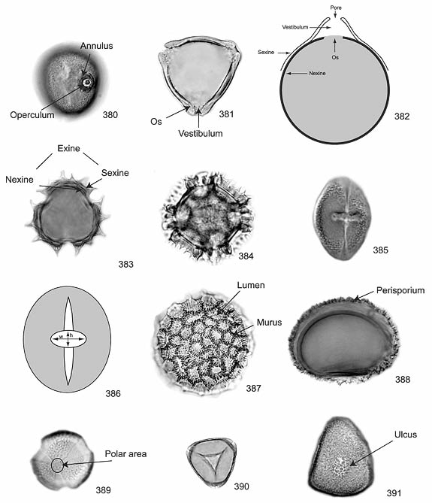
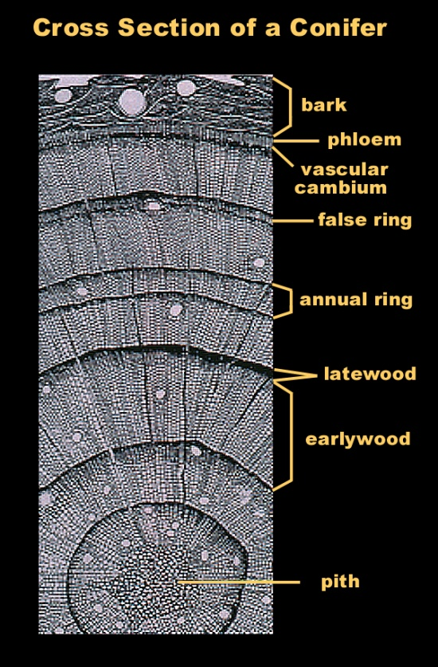
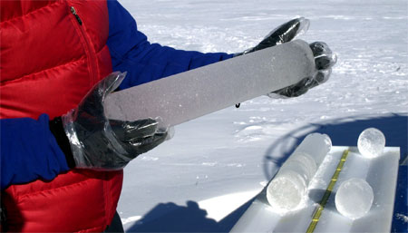
Paleoclimatology - The study of past climate, from times prior to instrumental weather measurements.
Proxy Data – Information from (mostly) natural recorders of climate variability.
Widely used proxy climate data include:
Tree Rings
Corals
Ice Cores
Fossilized Pollen
Notes:
Since tree growth is influenced by climatic conditions, patterns in tree-ring widths, density, etc, reflect variations in climate.� In temperate regions where there is a distinct growing season, trees generally produce one ring a year, and thus record the climatic conditions of each year.�Trees can grow to be hundreds to thousands of years old and can contain annually-resolved records of climate for centuries to millennia. A cross section of a young conifer Photo Credits: NOAA Paleoclimatology Program
Source: http://www.ncdc.noaa.gov/paleo/slides/slideset/index18.htm
Corals build their hard skeletons from calcium carbonate, a mineral extracted from sea water. The carbonate contains isotopes of oxygen, as well as trace metals, that can be used to determine the temperature of the water in which the coral grew. These temperature recordings can then be used to reconstruct climate when the coral lived. Two sections of a coral core from the Galapagos. The cores are x-rayed so scientists can see the growth bands. Next, segments are marked for sampling: black lines represent annual bands, blue and red lines subdivide the year into quarters. The core is then cut along the lines and the individual segments analyzed in a laboratory . Photo Credits: Rob Dunbar Dept. of Geology and Geophysics, Rice University
Source: http://www.ncdc.noaa.gov/paleo/slides/slideset/index13.htm
Located high in mountains and the polar ice caps, ice accumulates from snowfall over many millenia. Scientists drill through the deep ice to collect ice cores that contain dust, air bubbles, or isotopes of oxygen, that can be used to interpret the past climate of that area. A section of an ice core taken on the Clark Glacier in the McMurdo Dry Valleys. A 160-meter core was extracted to study the climate in the area over the past 2,000 years.
Credit : Emily Stone, Source: http://photolibrary.usap.gov/portscripts/portweb.dll?query&field1=filename&op1=matches&value=corecloseup.jpg&catalog=antarctica&template=usapgovmidthumbs
All flowering plants produce pollen grains. Their distinctive shapes can be used to identify the type of plant from which they came. Pollen grains are well preserved in the sediment layers of ponds, lakes or the ocean. An analysis pollen grains in each layer tell us what kinds of plants were growing at the time the sediment was deposited.� Inferences can then be made about the climate based on the types of plants found in each layer. Morphological features of pollen spores from the Florida Everglades (USGS) http://sofia.usgs.gov/publications/papers/pollen_atlas/plate21-23.html

Slide 4
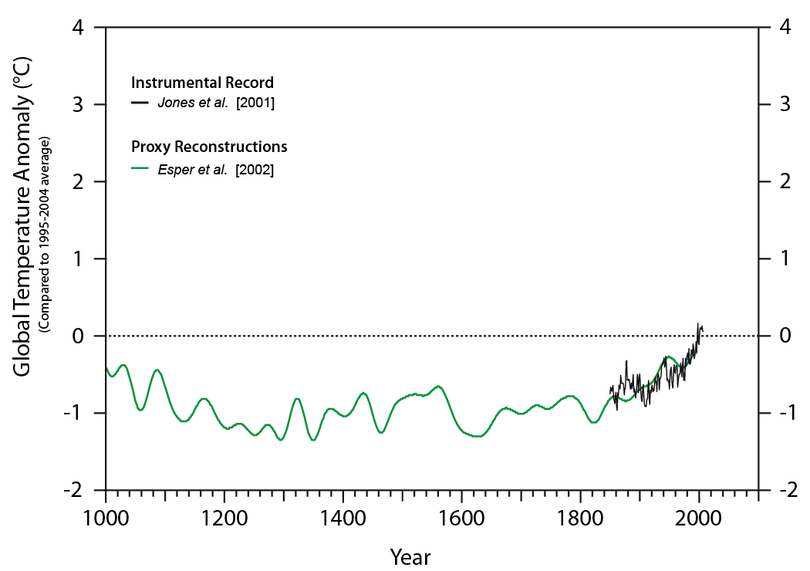
Notes:
Proxy Records
Temperatures deduced from natural records such as tree rings, corals, layers of ice, marine and lake sediments, and ground or ice temperatures.
----------------------------------------------------------------------------------------------------------
The Esper et. al. record was extracted from tree-ring chronologies from 14 sites in the Northern Hemisphere. Jan Esper and and Fritz Schweingruber are affiliated with the Swiss Federal Research Institute in Switzerland. Edward Cook is affiliated with Lamont-Doherty Earth Observatory at Columbia University, New York, in the United States.
Esper, J., E. R. Cook, and F. H. Schweingruber (2002), Low-Frequency Signals in Long Tree-Ring Chronologies for Reconstructing Past Temperature Variability Science 22 March 2002: Vol. 295 no. 5563 pp. 2250-2253 DOI: 10.1126/science.1066208

Slide 5
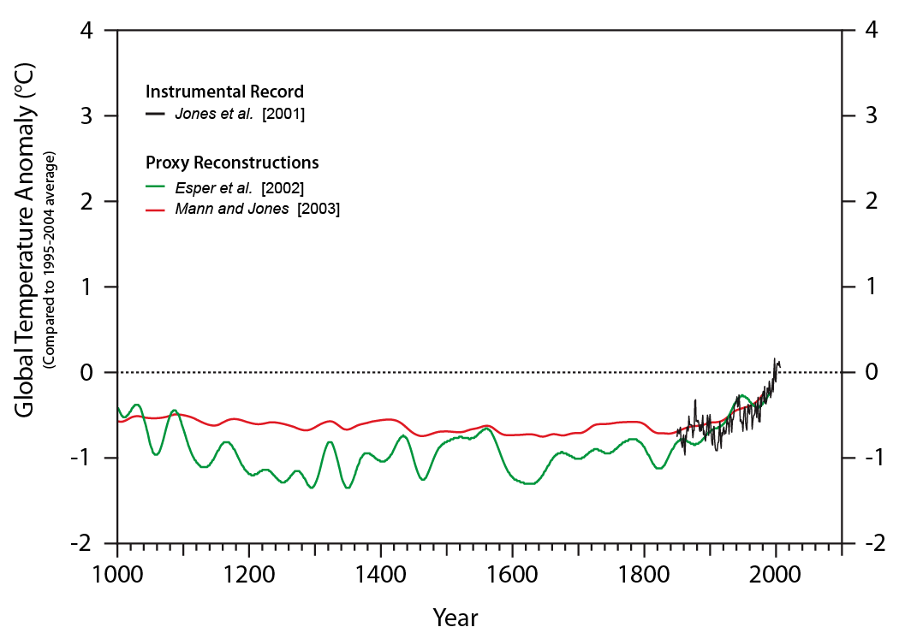
Notes:
Proxy Records
Temperatures deduced from natural records such as tree rings, corals, layers of ice, marine and lake sediments, and ground or ice temperatures.
----------------------------------------------------------------------------------------------------------
The Mann and Jones record of past temperatures is based on ice boreholes, ice cores, sediment records, and tree-ring chronologies. Michael E. Mann is affiliated with the Department of Environmental Sciences at the University of Virginia in Charlottesville, Virginia in the USA. Philip D. Jones is affiliated with the Climatic Research Unit at University of East Anglia in Norwich, in the United Kingdom.
Mann, M. E., and P. D. Jones (2003), Global Surface Temperatures over the Past Two Millennia Geophysical Research Letters Vol. 30, No. 15, 1820, August 2003 doi: 10.1029/2003GL017814

Slide 6
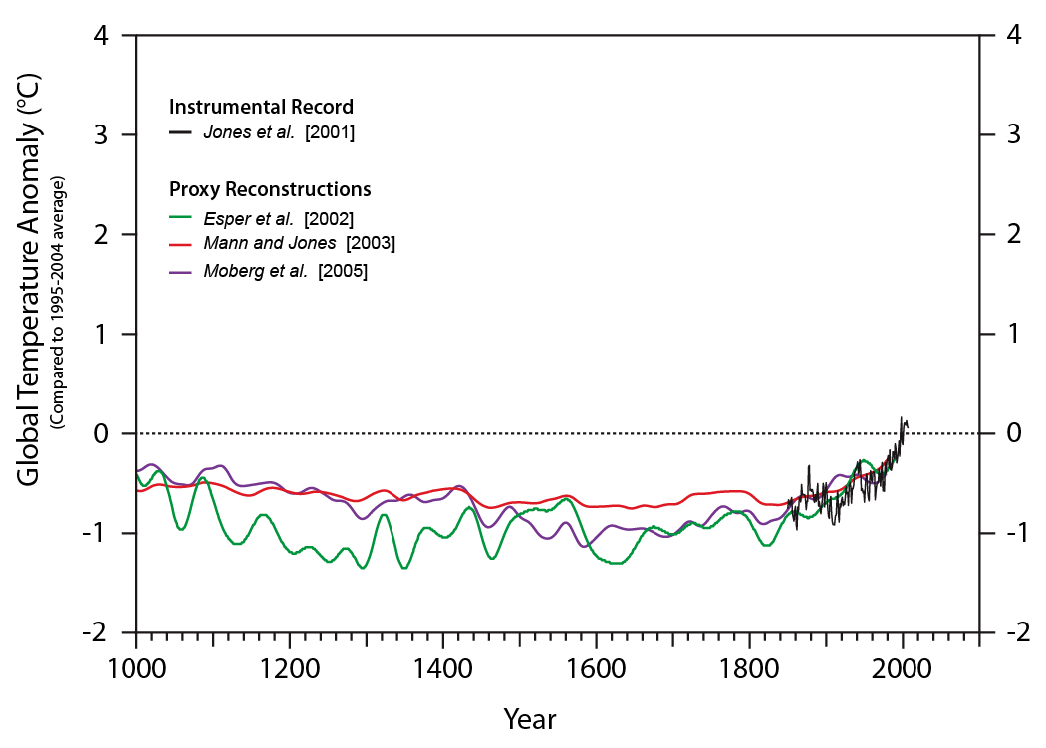
Notes:
Proxy Records
Temperatures deduced from natural records such as tree rings, corals, layers of ice, marine and lake sediments, and ground or ice temperatures.
----------------------------------------------------------------------------------------------------------
Anders Moberg and colleagues from Sweden and Russia published a temperature record deduced from tree rings and lake and ocean sediments.
Moberg, A., D. M. Sonechkin, K. Holmgren, N. M. Datsenko, and W. Karlén (2005), Highly variable Northern Hemisphere temperatures reconstructed from low- and high-resolution proxy data Nature, Vol. 433, No. 7026, pp. 613 - 617, 10 February 2005.

Slide 7
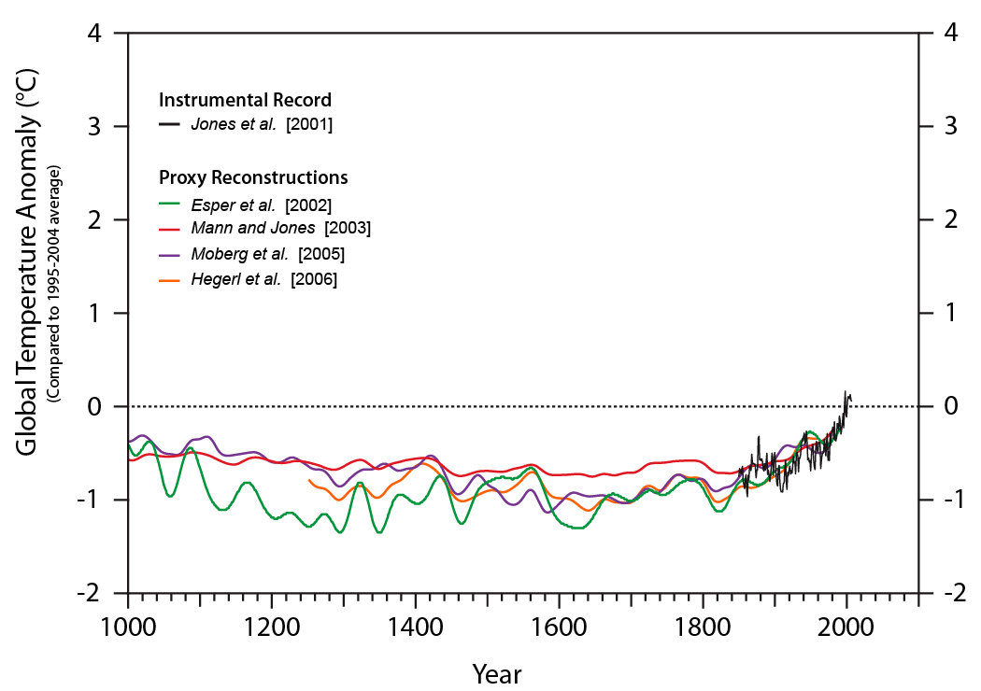
Notes:
Proxy Records
Temperatures deduced from natural records such as tree rings, corals, layers of ice, marine and lake sediments, and ground or ice temperatures.
----------------------------------------------------------------------------------------------------------
Gabriele Hegerl, along with two of her Duke University colleagues and a collaborator in the United Kingdom developed their temperature reconstruction as follows: “We use large-ensemble energy balance modeling and simulate the temperature response to past solar, volcanic and greenhouse gas forcing to determine which climate sensitivities yield simulations that are in agreement with proxy reconstructions. After accounting for the uncertainty in reconstructions and estimates of past external forcing, we find an independent estimate of climate sensitivity that is very similar to those from instrumental data.”
Hegerl, G. C., T. J. Crowley, W. T. Hyde, and D. J. Frame (2006), Climate sensitivity constrained by temperature reconstructions over the past seven centuries. Nature 440, 1029-1032 (20 April 2006) | doi:10.1038/nature04679

Slide 8
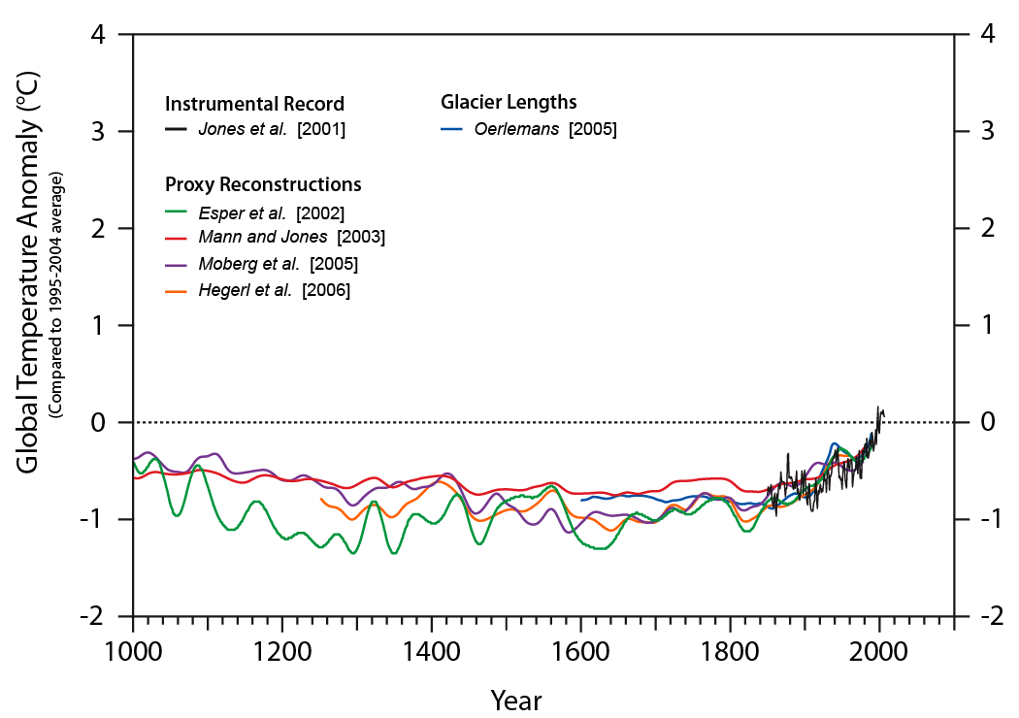
Notes:
Glacier Lengths
Historical paintings, photographs, and other documents enable researchers to estimate the change in glacier mass balance over time and deduce corresponding temperatures.
----------------------------------------------------------------------------------------------------------
J. Oerlemans of the Institute for Marine and Atmospheric Research at Utrecht University in the Netherlands constructed a temperature history for different parts of the world from 169 glacier length records. Using a first-order theory of glacier dynamics, he related changes in glacier length to changes in temperature. The derived temperature histories are fully independent of proxy and instrumental data used in earlier reconstructions.
Oerlemans, J. (2005) Extracting a Climate Signal from 169 Glacier Records Science Vol. 308, No. 5722, pp. 675-677, 29 April 2005.

Slide 9
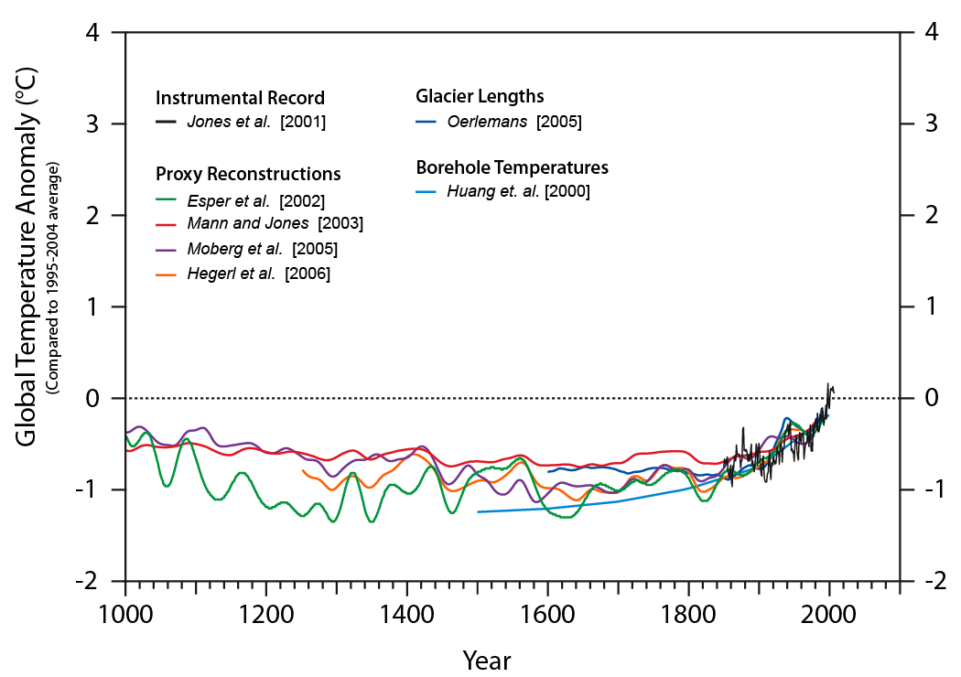
Notes:
Borehole Temperatures
Subsurface temperatures measured in boreholes register not only the steady state heat flowing out from Earth’s interior, but also changes in past surface temperature. Heat of the Earth’s atmosphere diffuses into the Earth’s crust such that progressively deeper regions of the subsurface hold signatures for the temperatures of progressively older times.
----------------------------------------------------------------------------------------------------------
Shaopeng Huang and a colleague at the University of Michigan, working with a collaborator from Canada used present-day temperatures in 616 boreholes from all continents except Antarctica to reconstruct century-long trends in temperatures over the past 500 years at global, hemispheric and continental scales.
Huang, S.. Pollack, H.N. & Shen, P.-Y. Temperature trends over the past five centuries reconstructed from borehole temperatures. Nature 403, 756-758 (17 February 2000) | doi:10.1038/35001556

Slide 10
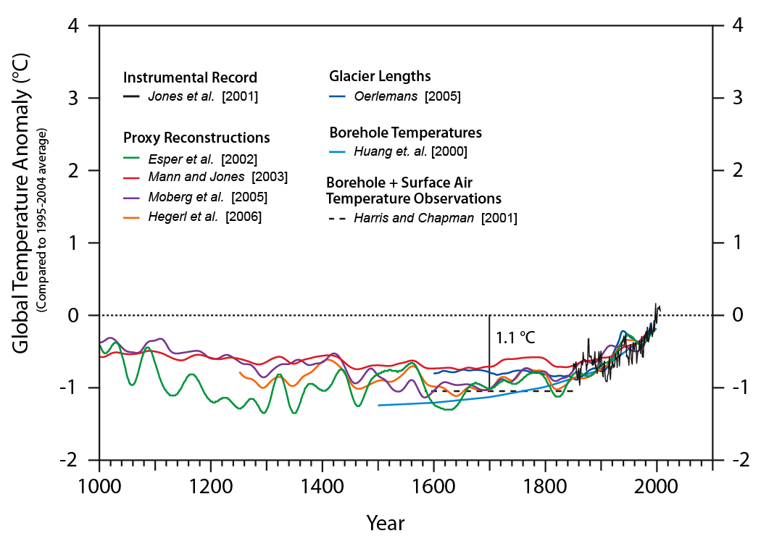
Notes:
Borehole + Surface Air Temperatures
Subsurface temperatures measured in boreholes register not only the steady state heat flowing out from Earth’s interior, but also changes in past surface temperature. Heat of the Earth’s atmosphere diffuses into the Earth’s crust such that progressively deeper regions of the subsurface hold signatures for the temperatures of progressively older times.
----------------------------------------------------------------------------------------------------------
Robert N. Harris and David S. Chapman, both of the University of Utah in the United States developed a temperature reconstruction using a hybrid approach that utilized both borehole and surface air temperature information. Their method yielded a baseline temperature prior to the instrumental record, suggesting warming of about 1.1°C since ~1750.
Harris, R. N., and D. S. Chapman (2001), Mid‐latitude (30°–60° N) climatic warming inferred by combining borehole temperatures with surface air temperatures, Geophys. Res. Lett., 28(5), 747–750, doi:10.1029/2000GL012348.

Slide 11
Activity: Paleoclimates & Pollen
All flowering plants produce pollen grains with distinctive shapes.
Plants are generally distributed based on patterns of temperature and precipitation.
Plant communities change as climatic factors change.
By knowing conditions that plants prefer, we can make inferences about past climate.

Slide 12
Activity: Paleoclimates & Pollen
By examining the pattern of plant changes over time, scientists can:
determine how long it took for plant species to migrate into or out of an area due to climate change.
predict the speed in which plant communities might change in response to human induced climate change
predict which plants will be most likely to thrive if the climate warms again.

Slide 13
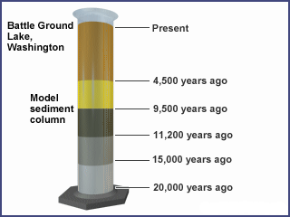
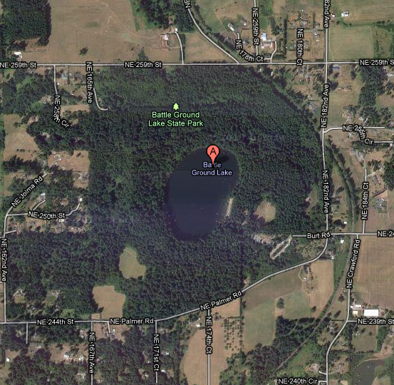
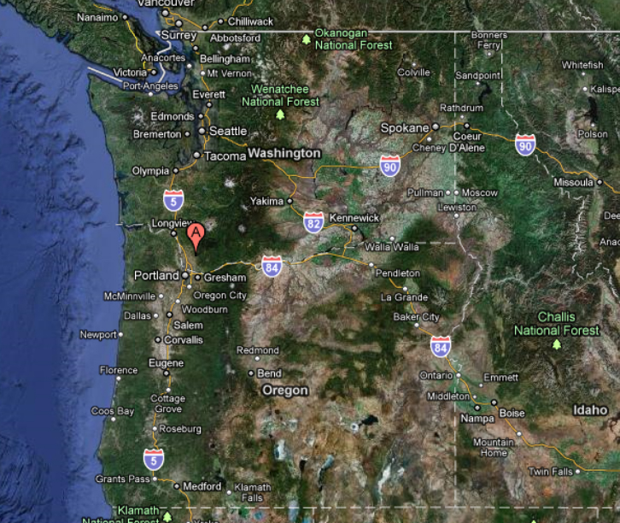
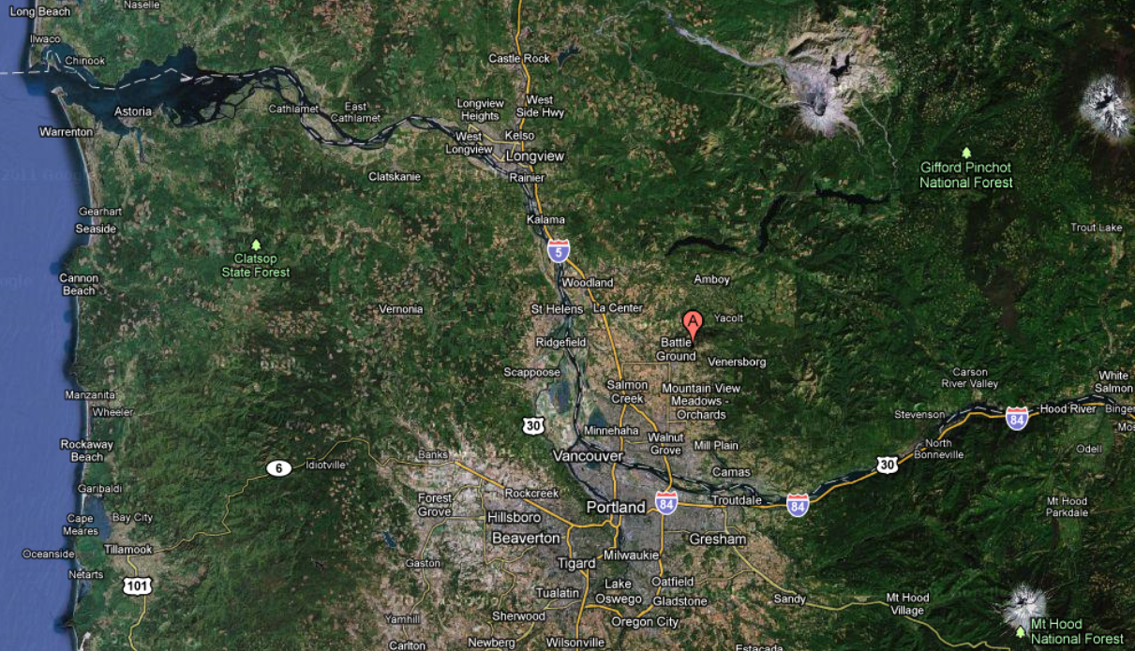
Activity: Paleoclimates and Pollen
Battle Ground Lake, Washington
The Age of each sediment layer has been determined by radiocarbon dating, and referencing volcanic ash layers of known age from Mt. St. Helens and from the explosion of Mt. Mazama (Crater Lake in Oregon).
Notes:
Battle Ground Lake is located 30 km north of the Columbia River, in Clark County Washington, near the town of Battle Ground.
The lake has been in existence for at least the last 20,000 years and has continuously accumulated sediments through most of that time. Trapped in the sediments are pollen grains from the plants that grew in the general vicinity of the lake at the time the sediments were deposited. By examining the pollen in different layers of sediment from the bottom layer to the top, we can reconstruct the vegetation changes that have occurred in the area during the lake's existence. Because we know something about the climatic conditions that the plants needed to survive, we can use the vegetation data to reconstruct the past climate in the area for the entire 20,000-year period.
Many layers have been identified by paleoclimatologists. For the sake of simplicity, we will combine these into five major layers. The age of each layer has been established by radiocarbon dating and by reference to volcanic ash layers of known age from Mt. St. Helens and from the explosion of Mt. Mazama (now Crater Lake in Oregon).

Slide 14
Color Code | Plant Species | Climatic Characteristics
White | Western Hemlock | Dominant tree of many lowland, temperate sites. Requires very moist, temperate conditions for growth.
Brown | Douglas Fir | Broadly distributed throughout the Pacific Northwest from moderately cool to warm sites. Grows best under temperate, somewhat moist conditions.
Dark Green | Grasses & Sedges | Typically found in very cool alpine/subalpine meadow sites characterized by very cool summers, harsh winters, and short growing seasons.
Red | Alder | Widespread throughout the Pacific Northwest, often colonizing gravel bars or other poor soils, prefers abundant water and can grow in cool climates.
Pink | Grand Fir | Found at mid-elevations in the Cascade mountains. Grows in cool climates, but not as cold tolerant as trees found at higher altitudes.
Light Green | Engelmann Spruce | Found in cold, usually sub-alpine sites.
Dark Blue | Western Cedar | Found only in temperate, very moist climates.
Light Blue | Lodgepole Pine | Found in areas of very cool climates typically growing on poor soils, often at high altitudes (above 3,500 feet) under the present climate.
Light Yellow | Mixed Meadow Species | A mixture of herbaceous plants common to warm - temperate meadowlands, such as the Willamette Valley in Oregon. Typically, these species grow in areas of warm summer temperatures and summer drought.
Bright Yellow | Oak | Found in warm - temperate sites characterized by dry, warm summers such as can be found from Oregon's Willamette Valley south into California.
Cream / Almost White | Alpine Sagebrush | Woody, low-growing shrub related to the sagebrush of eastern Washington and Oregon. Found only at high-altitude, cold sites.

Slide 15
Activity: Paleoclimates and Pollen
What species of plant pollen are in each sediment sample?
What percentage of the total pollen in each sample comes from each species?
What climate is indicated by the pollen sample in each layer of sediment?
Describe the overall pattern of climate change over the last 20,000 years?

Slide 16
Layer | Time Period | Description
#1 | 4,500 years before present (ybp) - Present | A cooler and moister period than the previous one. Dry-land vegetation is replaced by the extensive closed coniferous forests seen today, with hemlock and western red cedar dominating areas of forest undisturbed by logging.
#2 | 9,500 - 4,500 ybp | The climate continues to warm with mild, moist winters and warm, dry summers predominating. Forests of the previous period (which needed cooler, moister conditions) disappear and are replaced by more drought-adapted mixed oak, Douglas fir, and a dry meadowland community. Today, such vegetation is typical of areas of the Willamette Valley of Oregon that have escaped cultivation.
#3 | 11,200 - 9,500 ybp | The warming continues and the first occurrence of "modern," temperate coniferous forest is found. Douglas fir, alder, and grand fir dominate in forests similar to those that occur today. The climate is similar to today's climate as well.
#4 | 15,000 - 11,200 ybp | Glaciers begun to recede as the climate starts to warm. Although still cold in comparison to the present climate, warming has progressed enough to allow more extensive forests of lodgepole pine, Engelmann spruce, and grand fir to replace tundra vegetation in an open woodland setting. Further north in northern and central Puget Lowland, glacial recession has opened up many new areas to plant colonization, and lodgepole pine has invaded these new areas.
#5 | 20,000 - 15,000 ybp | Glacial maximum, nearly a vertical mile of ice over what is Seattle today. Continental glaciers extending south of the present site of Olympia. An alpine glacier from Mt. St. Helens extended down the Lewis River Valley to within 30 km of the lake. The lake area climate was cold, with a short growing season. The landscape resembled an arctic/alpine tundra, with alpine grasses/sedges, low woody shrubs, and scattered tree islands of cold-tolerant Engelmann spruce and lodgepole pine dominating the meadows.
Notes:
Reference: Barnosky, C. W., 1985. Late quaternary vegetation near Battle Ground Lake, southern Puget Trough, Washington. Geological Society of America Bull., 96, 263 - 271.

